Slide 1
Module & global coordinates
Author: Nicole Apadula
Version: 1.0
Date: 10/16/2026
Definitions of local and global coordinates and mapping onto disks

Slide 2
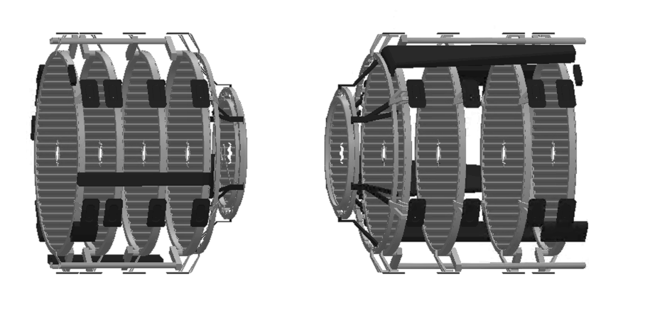
Right-handed global coordinate system
ED4
ED3
ED2
ED1
HD1
HD2
HD3
HD4
y
ED0
HD0
x
+ z
- z

Slide 3
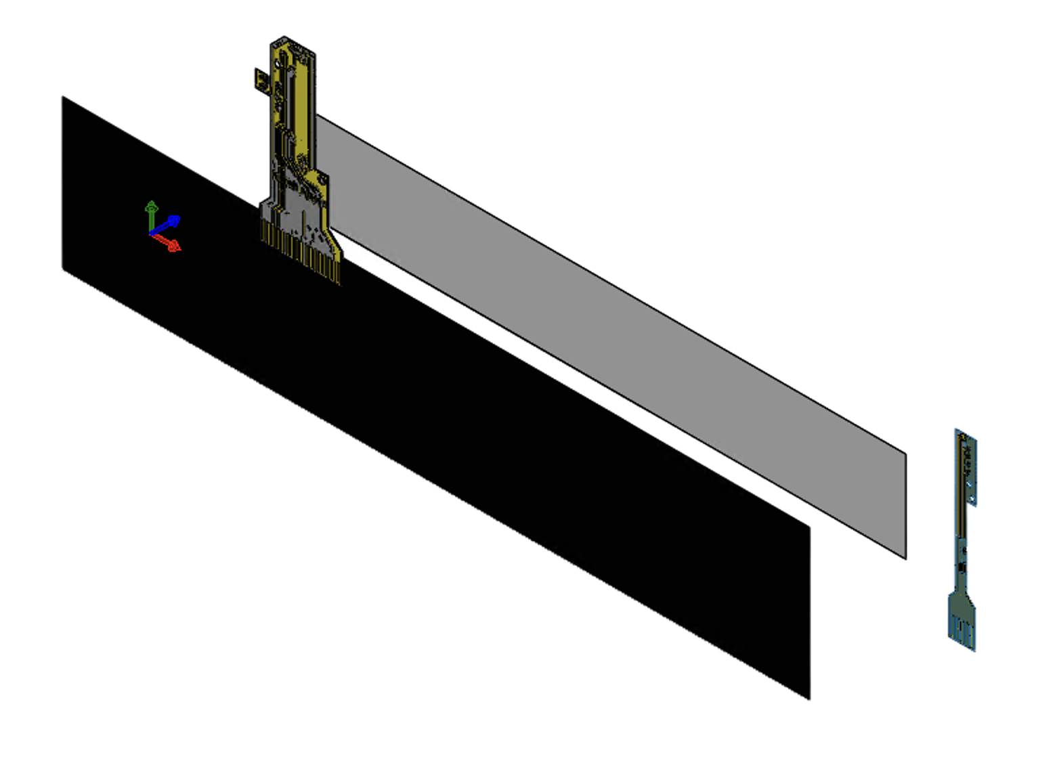
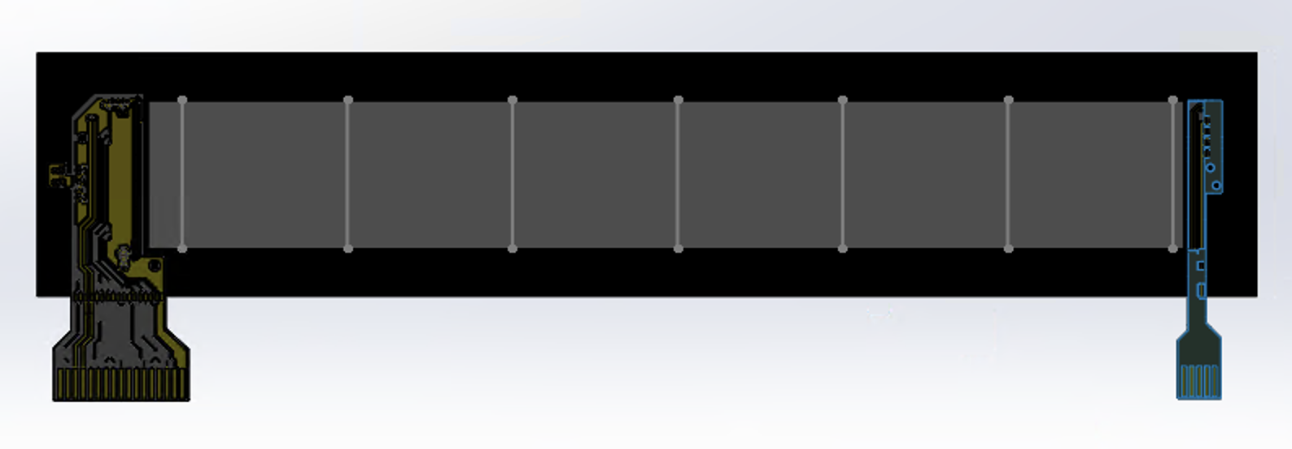
Local module coordinates
y
x
z
Local coordinate system is defined by the sensor. Origin is at the border between LEC & RSUs
X goes towards REC
Y goes upwards towards the top tiles from the center of the RSU
Z comes out away from the carbon fiber

Slide 4
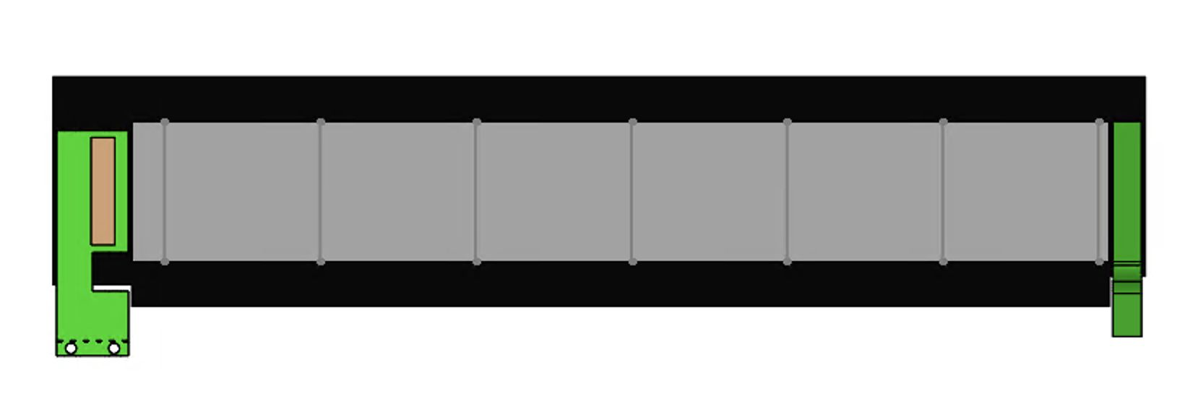
Local module coordinates
Direction of FPC does not change local coordinate system
y
x
z

Slide 5
Global coordinates
Picking one case: ED1
ED4
ED3
ED2
ED1
HD1
HD2
HD3
HD4
y
ED0
HD0
x
+ z
- z

Slide 6
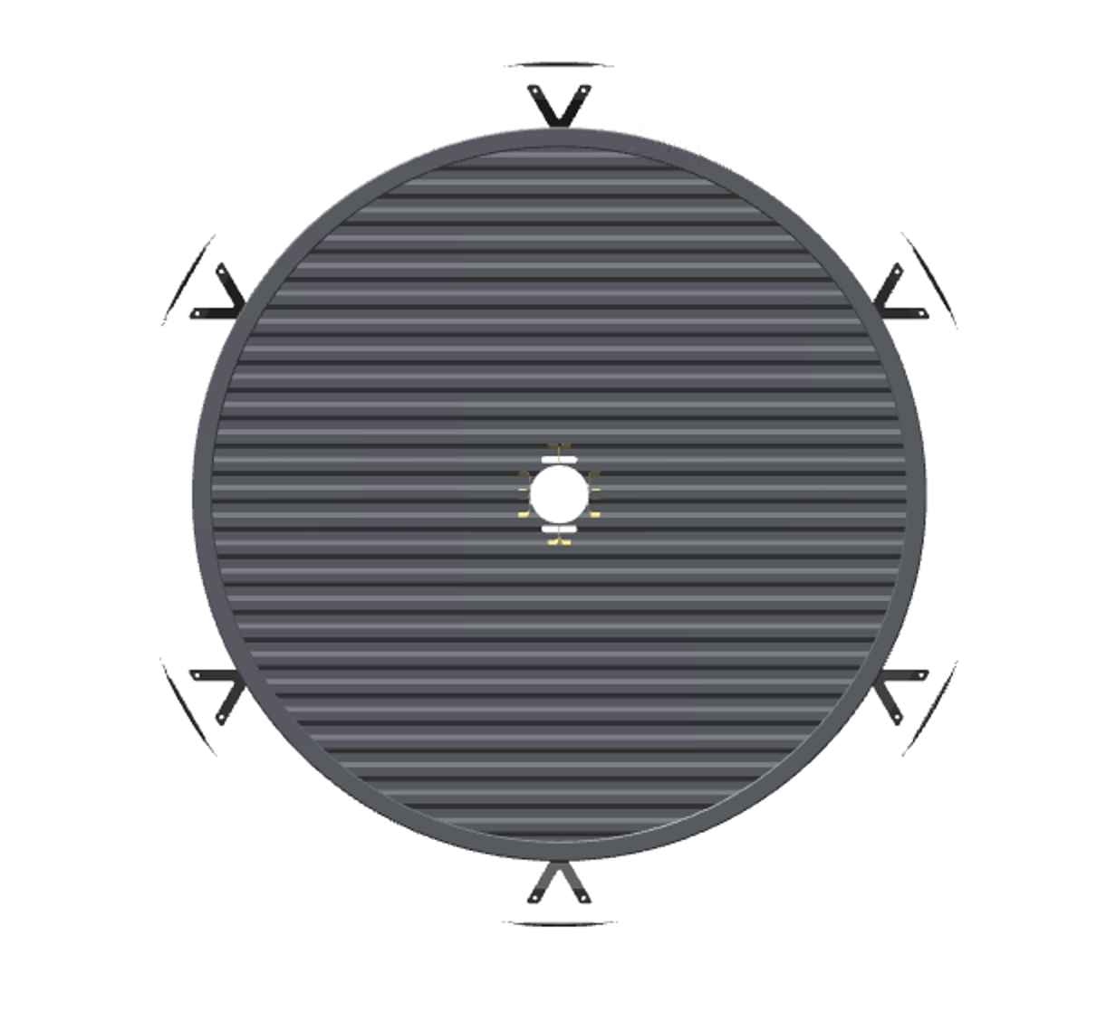
One side of ED1
Global coordinates
y
x
z

Slide 7
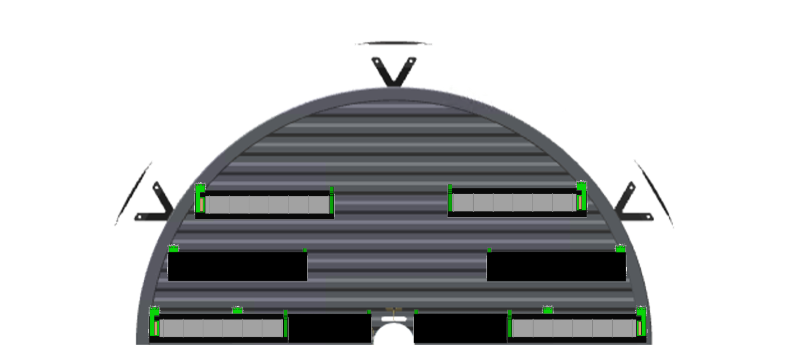
Modules used on ED1
Global coordinates
y
Only taking this one case scenario:
Top half (defined by being in pos global y)
Back face (defined by being at larger global z)
x
z
4 modules orientations used, close ups shown in the next slide

Slide 8


Local module coordinates – module rotations on ED1 case (previous slide)
y
x
x
z
y
z
y
x
x
z
z
y

Slide 9
Mapping to global coordinates
Global coordinates
y
y
x
z
x
z
sx = 1
sy = 1
sz = 1
→ sx*sy*sz = 1, Left Chirality

Slide 10
Mapping to global coordinates
Global coordinates
y
x
z
y
x
z
sx = 1
sy = -1
sz = -1
→ sx*sy*sz = 1, Left Chirality

Slide 11
Mapping to global coordinates
Global coordinates
y
x
z
y
x
z
sx = -1
sy = -1
sz = 1
→ sx*sy*sz = 1, Left Chirality

Slide 12
Mapping to global coordinates
Global coordinates
y
y
x
z
x
z
sx = -1
sy = 1
sz = -1
→ sx*sy*sz = 1, Left Chirality

Slide 13
Proposition
Modules are defined locally
All movements are based on the currently defined module coordinate system and the local origin (defined earlier)
Direction of FPC defines handedness
  The FPC either extends to positive y (right handed) or to negative y (left handed)
Inward or outward facing flips the z
  Inward and the z axis is now extending away locally

Slide 14
WIP for naming

